Slide 1
Video Compression - SBI
Powered By - Microsoft Corporation Pvt Ltd.

Slide 2

Problem Being Solved
Problem statement: “How to compress video for archiving using Azure resources?”

Slide 3
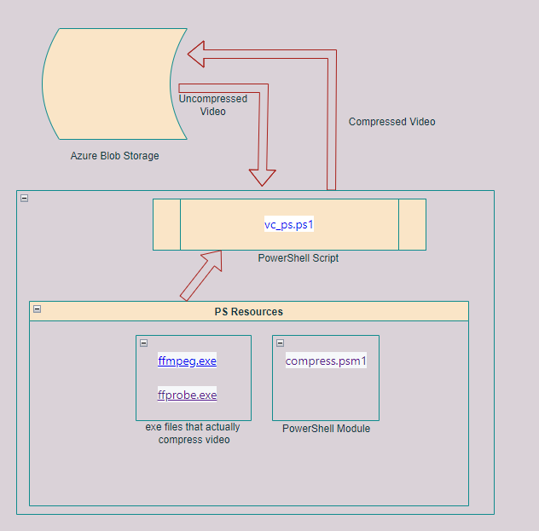
Approach taken to create the model

Slide 4
Prerequisites
Sample Video file for testing prototype.
Resolution of the final file.
Frames per second expected in the final file.
Hardware Test bench details

Slide 5
Any supporting assumptions, functional requirements(FR) and non-functional requirements(NFR)
PowerShell version 7 + is required for this to work

Slide 6
reason why your solution should be considered
It’s easy to implement and easy to migrate

Slide 7
Source code (Github Repository Link)
https://github.com/shamvil89/Compressor

Slide 8
Demonstration Video showing the
functionalities/working of the solution.

Slide 9

Submitted By :
Email :
Mobile No:

